Slide 1
Under the guidance of
D.RAMESH Assistant Proffesor ,CSE
P
&
H
Pneumonia and Heart analysis
Through deep learning
TEAM-29

Slide 2
TEAM MEMBERS
19K41A0506 VONTELA DHANUSH
19K41A0590 AMOGH VARSH RAJU AMBATI
19K41A05E3 SARDAR KAMALJEETH SINGH
19K41A05G3 MOHD AMAAN
19K41A05H2 THALLAPALLY VINAY PRAKASH
TEAM-29

Slide 3
CONTENTS
INTRODUCTION
DATA-SET
PRE-PROCCESING
MODELS & IMPLEMENTATION
Result & Output

Slide 4
PART
01

Slide 5
INTRODUCTION
MEDICAL USAGE
CHEST-X-RAY
Can be used by chest physians
Transaprent image of the chest
Why?
1. To reduce cost of patients
2.For easier analysis and guidance
3.Economical benifit
PNEUMONIA
Formation of puss inside the human lungs
FINAL OUTCOME
DEATH
EFFECTS
COUGH,Pain in chest, fever all th time

Slide 6
INTRODUCTION
CXR’s
5
RADIOLOGISTS
DATA-SET
4
6
TARGET
3
7
MODELS
KEYS
SOLUTION
2
8
TRAINING
1
9
VALIDATION
PROBLEM

Slide 7
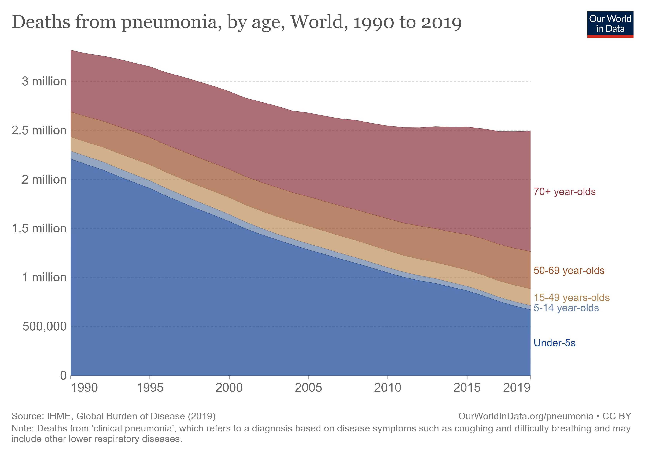

THE PROBLEM
DATA
The data suggests the amount of deaths is considerably declined yet it is still an mas problem
MORTALITY RATE
ADD TITLE
In Need of Effective diagnosis

Slide 8
PART
02

Slide 9
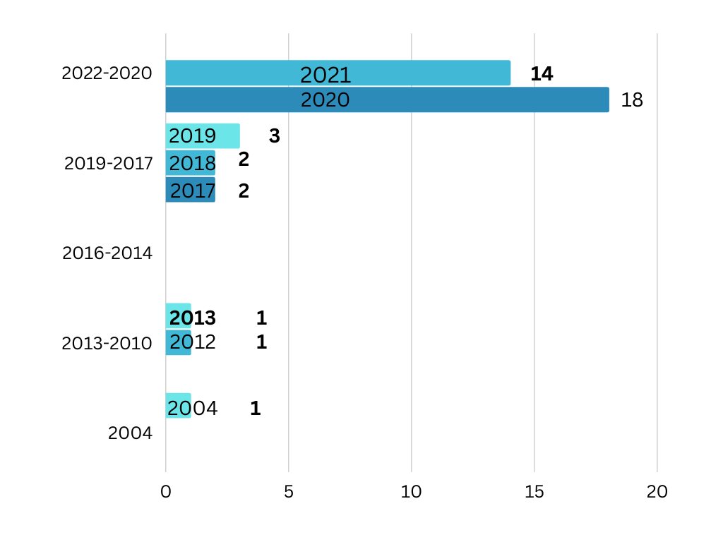
LITERATURE SURVEY

Slide 10
DATA-SET Details
VAL
Consists of agumented data of about 18 images
2.3
THE DATA-SET whole size is about 2.3 gigabytets of cxr’s
CXR’s
TEST
Consists of test data worth 624 CXR images
TRAIN
Consists of 2 diseases normal and diseased CXR’s of 5,218 images

Slide 11
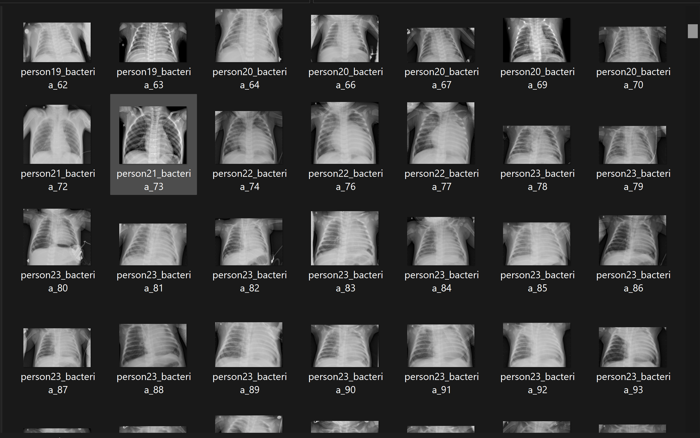
DATA-SET INSIGHTS

Slide 12

CHALLENGES WITH THE DATASET
HUGE DATASET
MEMORY ISSUES
COMPUTATIONAL SPACE

Slide 13
PART
03

Slide 14
PRE-PROCESSING
READING TRAIN,TEST,VAL DATA
RESIZE OF images
NORMALIZATION
FLOAT16

Slide 15
PRE-PROCESSING
APPEND THE LABEL
WHEN A DISEASE IS FOUND OR NORMAL IMAGE IS FOUND APPEND IT TO THE ARRAY AND LABELS BASED ON THE CONDITIOON MENTIONED
LOOP FOR DISEASED IMAGES
WE ARE GOING TO SEARCH FOR THE WHOLE IMAGES AND THEN APPEND IT BASED ON ITS CLASSIFICATION

Slide 16
FLOW
READING OF DATA
Pre-proccesing flow
Determines the properties of the model which is to be imolemented
RESIZE AND APPEND
CONVERSION INTO NUMPY ARRAY

Slide 17
PART
04

Slide 18
MODEL IMPLEMENTATION
CUSTOM CNN
TRANSFER LEARNING
Transfer learning is a machine learning technique where a pre-trained model is used as a starting point for a new task or problem.
ADDED 16 filters of size 7*7 and used non-linear activation fiunction called RELU
VGG-16
RESNET-152
Converted the 4D output tensor into 2D and connected with 3 new nodes with the pretrained VGG-16 layer with SOFTMAX activation function
Followed the same technique as VGG-16 and used ADAM OPTIMIZER

Slide 19

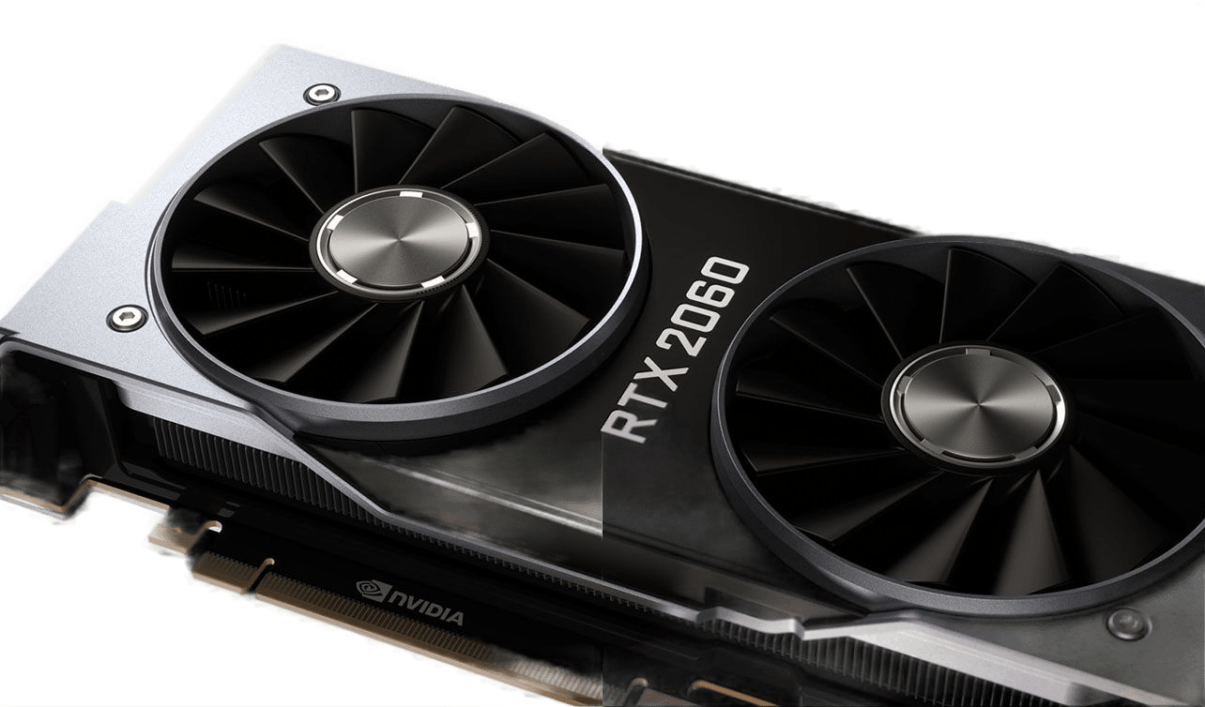
Hardware elements playing crucial role
The GeForce RTX 2060 features 1,920 CUDA cores, 240 Tensor Cores that can deliver 52 teraflops of deep learning horsepower
6gb of vram
16gb ram
intel i9 10th gen

Slide 20
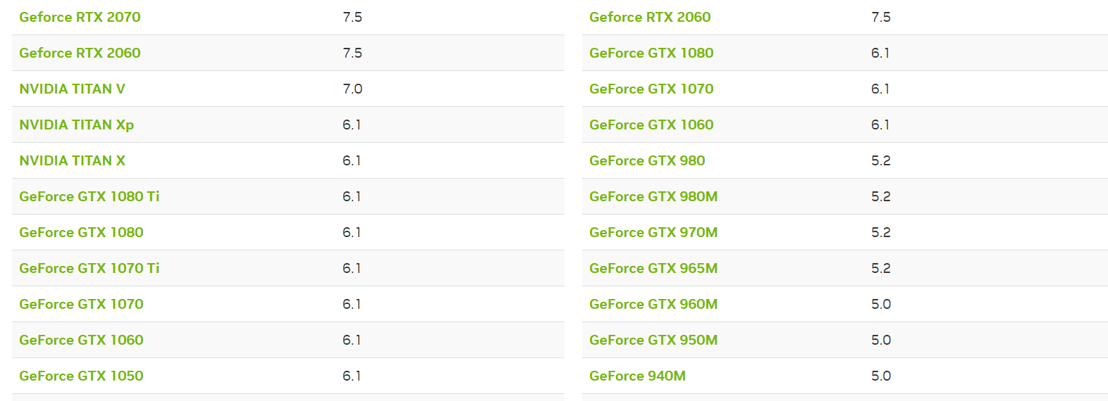
COMPUTE CAPABILITY

Slide 21
The Results.
S.NO | Model Used | ACCURACY |  |  | Precision |  |  | Recall
 | Folders > | Train | Test | Val | Train | Test | Val | Train | Test | Val
1 | Custom CNN | 0.7601 | 0.6617 | 0.875 | 0-0.94 1-0.96 2-0.68 | 0-0.99 1-0.80 2-0.48 | 0-1.0 1-0.00 2-0.88 | 0-0.99 1-0.10 2-0.81 | 0-0.47 1-0.15 2-0.65 | 0-0.88 1-0.00 2-0.88
2 | VGG-16 | 0.8932 | 0.6474 | 0.875 | 0-1.00 1-0.97 2-0.83 | 0-0.991-0.522-0.62 | 0-1.00 1-0.002-0.88 | 0-1.00 1-0.61 2-0.99 | 0-0.38 1-0.51 2-0.99 | 0-0.88 1-0.00 2-0.88
3 | RESNET 152 | 0.7875 | 0.6762 | 0.875 | 0-1.83 1-0.80 2-0.76 | 0-0.88 1-0.64 2-0.61 | 0-0.80 1-0.00 2-1.00 | 0-0.99 1-0.36 2-0.91 | 0-0.51 1-0.44 2-0.98 | 0-1.00 1-0.00 2-0.86

Slide 22
The Output.
Analysis
3 Classes diseas percentage
Analysis
Analysis
Analysed
We are able to succesfully potray the result of the disease present in the x-ray and the different classes of it along with the kernel output on the layer of which the model is able to see.
Analysis
Analysis
Output
Analysis

Slide 23
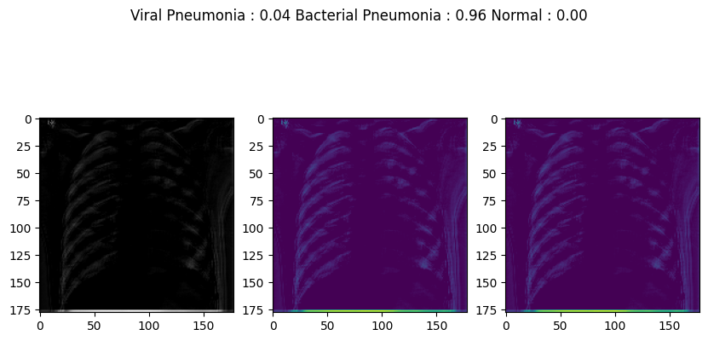
THE OUTPUT

Slide 24
THANK YOU
TEAM -29

